Slide 1

UNIT 1: What’s happening?

Slide 2
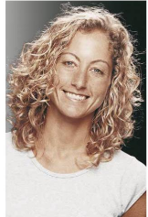

02
Listening

Slide 3
02
Listening
Task 1
exams
friends
sports
hobbies
boyfriend
part-time job

Slide 4
02
Listening
Task 2
1. Why is Kim studying very hard right now?
She’s studying hard because she has exams soon.

Slide 5
02
Listening
Task 2
2. What team is she playing for in college?
She’s playing for the women’s soccer team in college.

Slide 6
02
Listening
Task 2
3. What’s her part time job?
She works part-time in a convenience store.

Slide 7
02
Listening
Task 2
4. Why is she working weekends this month?
She’s working weekends this month because she needs the money.

Slide 8
02
Listening
Task 2
5. What is she learning to do?
She’s learning to drive.

Slide 9
02
Listening
Interviewer: So, Kim, can you tell me a little about what’s happening in your life these days?
đang học
Kim: Sure! Well, I’m very hard right now because I have soon.
những bài kiểm tra

Slide 10
02
Listening
Interviewer: Ah, exams! Good luck.
Kim: Thanks. They’re my final exams, so they’re .
I’m also
quan trọng
đang chơi
đội bóng nữ
in college, and right now we’re
winning all our matches, so that’s good!

Slide 11
02
Listening
Interviewer: That’s great.
Kim: Yeah. I’m really enjoying it.
đang học chăm chỉ
Interviewer: So you’re and playing a lot of sports. I guess you don’t have time for a job?

Slide 12
02
Listening
1 công việc bán thời gian
Kim: Oh, I have .
I work in .
1 cửa hàng tiện lợi
I’m working
working weekends this month, too, because I need the money.

Slide 13
02
Listening
Interviewer: Oh, yes? Why?
Kim: I’m ! It’s expensive, so my father is teaching me.
đang học lái xe
Interviewer: Wow, Kim. You’re very busy these days.

Slide 14

03
Speaking

Slide 15
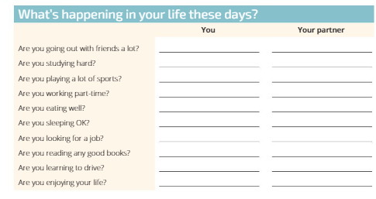
Speaking

Slide 16
Speaking
Talk in 45 seconds about at least 3 things you are doing.

